Slide 1

Contact:
djacobs1@uncc.edu
Part 3
Monte Carlo and
Free Energy Functional Method
Donald Jacobs, Professor
Department of Physics and Optical Science

Slide 2
Outline
Understanding the minimum Distance Constraint Model (mDCM)
Generic constraint characteristics
Meaning of constraint theory as used in the DCM
Simple Free Energy Decomposition (FED)
Importance of defining a complete set of interactions
FED for the mDCM and its partition function
Constructing the free energy functional for the mDCM
Selection of order parameters
Application of inhomogeneous mean field theory
Numerical calculation of the free energy landscape
Selected results on proteins
A
B
C

Slide 3
Generic Constraint Characteristics
Within an energy tolerance: Atoms wiggle around
Interactions are ranked ordered from strongest to weakest
Within ΔE the width of the potential energy well quantifies the strength of an interaction
Low conformational entropy restricts motions the most
High conformational entropy restricts motions the least

Slide 4
Meaning of Constraint Theory as used in the DCM
Express the energy function in terms of independent variables
Energy of network =
Position of k-th atom =
for a total of N atoms
Length of c-th distance constraint =
Typically, N_{c} > 3N-6
Degeneracy of c-th distance constraint =
A complete independent set of distance constraints =
Consequently, for each atom:
Upper bound estimate for degeneracy =
Astronomical many estimates
Lowest Upper Bound =
Minimum total pure entropy =
≈ constant energy surface

Slide 5
Simple example: Free Energy Decomposition (FED)
Define a complete set of interaction types
angle constraints
are modeled as next
nearest neighbor
distance constrains
FED
strong bond
weak bond
strong angle
weak angle
γ₁ < γ₂ < γ₃ < γ₄
rank order

Slide 6
Different Topologies Differ in Energy and Entropy
Network rigidity is regarded as an underlying mechanical interaction
N_{total} = N₁ + N₂ + N₃ + N₄
N_{total} = 4 + 1 + 2 + 2
H_{total} = N₁ε₁ + N₂ε₂ + N₃ ε₃+ N₄ε₄
FED
H_{total} = 4ε₁ + 1ε₂ + 2ε₃ + 2ε₄
strong bond
weak bond
strong angle
weak angle
I_{total} = I₁ + I₂ + I₃ + I₄
I_{total} = 4 + 1 + 0 + 0
N_{total} = 9
H_{total} = 4ε₁+ε₂+2ε₃+2ε₄
τ_{total} = I₁γ₁ + I₂γ₂ + I₃ γ₃+ I₄γ₄
γ₁ < γ₂ < γ₃ < γ₄
I_{total} = 5 (invariant)
τ_{total} = 4γ₁ + 1γ₂ + 0γ₃ + 0γ₄
rank order
τ_{total} = 4γ₁ + γ₂

Slide 7
Different Topologies Differ in Energy and Entropy
Network rigidity is regarded as an underlying mechanical interaction
N_{total} = N₁ + N₂ + N₃ + N₄
N_{total} = 4 + 0 + 0 + 4
H_{total} = N₁ε₁ + N₂ε₂ + N₃ ε₃+ N₄ε₄
FED
H_{total} = 4ε₁ + 0ε₂ + 0ε₃ + 4ε₄
strong bond
weak bond
strong angle
weak angle
N_{total} = 8
I_{total} = I₁ + I₂ + I₃ + I₄
H_{total} = 4ε₁+ 4ε₄
I_{total} = 4 + 0 + 0 + 1
I_{total} = 5 (invariant)
τ_{total} = 4γ₁ + γ₄
τ_{total} = I₁γ₁ + I₂γ₂ + I₃ γ₃+ I₄γ₄
γ₁ < γ₂ < γ₃ < γ₄
τ_{total} = 4γ₁ + 0γ₂ + 0γ₃ + 1γ₄
rank order

Slide 8
Different Topologies Differ in Energy and Entropy
Completeness ➔ All mechanical frameworks are 100% rigid.
Framework 1
Framework 2
Framework 3
-TS
H
H
-TS
H
-TS
Most Rigid
Intermediate
Most Flexible
Remark: For each interaction, the assigned entropic contribution quantifies the independent wiggling of atoms as their movements collectively allow the entire protein to explore conformational space at constant energy.

Slide 9
A Simple FED to Model Intramolecular Interactions
Modeling complex multi-particle interactions with multiple bars
Interaction list:
Remark:
Within the body-bar representation of network rigidity it is possible to model a single interaction using multiple bars.
COVALENT BOND
5 constraints each with (ε₁, 5γ₁)
HYDROGEN BOND
3 constraints each with (ε₂, 3γ₂)
NATIVE TORSION ANGLE
1 constraint with (ε₃,γ₃)
DISORDERED TORSION ANGLE
1 constraint with (ε₄,γ₄)
RANK ORDER:
γ₁ < γ₂ < γ₃ < γ₄

Slide 10
Entropy Spectrum Rank Orders Interaction Strength
Homogeneous system: An illustrative example
γ₁ < γ₂ < γ₃ < γ₄
stack of bars
RANK ORDER:
N₃ + N₄ = fixed sum
N₃
Given: 250 residue protein
Fixed # of covalent bond constraints = N₁ = 10800 = 5×2160
Fixed # of torsion angle constraints = N₃ + N₄ = 1200
Variable # of H-bond constraints = 0 ≤ N₂ ≤ 1200 = 3×400
Variable # of native torsion constraints = 0 ≤ N₃ ≤ 1200
N₂
N₁ fixed

Slide 11
Define Macrostates of a Protein by Order Parameters
Group the ensemble of mechanical frameworks into bins
γ₁ < γ₂ < γ₃ < γ₄
stack of bars
RANK ORDER:
FLUCTUATING H-bonds and native torsions
Consider 3 specific macrostates: C, B, A
N₃
N₃
C
very rigid
N₂
more native torsion constraints
B
intermediate
A
very flexible
more H-bond crosslink constraints
N₂

Slide 12
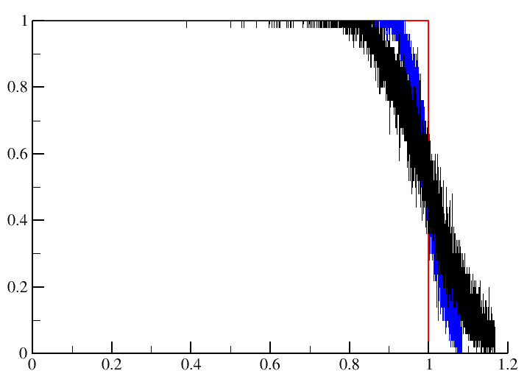
P’s and Q’s
Examples
(total # of constraints placed)
(maximum # of independent constraints)
P =
Q = <fraction of (N₂ + N₃ + N₄) that are independent>
uniform sampling
within A, B and C.
Q
N₃
C
50 samples
B
A
N₂
Run body-bar pebble game for each sample, for nodes A, B and C.
P

Slide 13
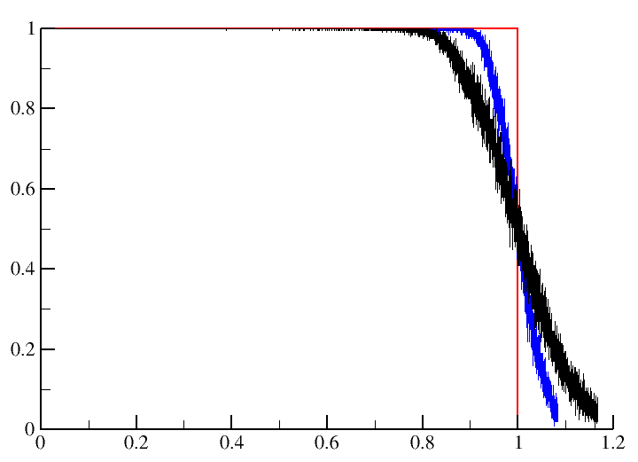
P’s and Q’s
Examples
(N₁ + N₂ + N₃)
(N₁ + N₂ + N₃ + N₄)
P =
Q = <fraction of (N₂ + N₃ + N₄) that are independent>
uniform sampling
within A, B and C.
Q
N₃
C
200 samples
B
A
N₂
Run body-bar pebble game for each sample, for nodes A, B and C.
P

Slide 14
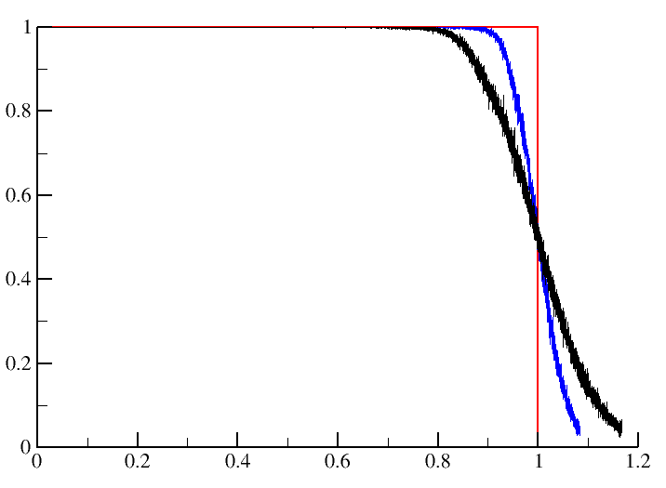
P’s and Q’s
Examples
(N₁ + N₂ + N₃)
(N₁ + N₂ + N₃ + N₄)
P =
Q = <fraction of (N₂ + N₃ + N₄) that are independent>
uniform sampling
within A, B and C.
Q
N₃
C
800 samples
B
A
N₂
Run body-bar pebble game for each sample, for nodes A, B and C.
P

Slide 15
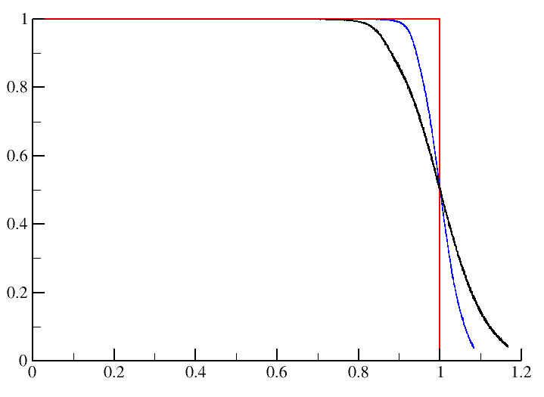
P’s and Q’s
Examples
(N₁ + N₂ + N₃)
(N₁ + N₂ + N₃ + N₄)
P =
Q = <fraction of (N₂ + N₃ + N₄) that are independent>
uniform sampling
within A, B and C.
Q
N₃
C
12800 samples
B
A
N₂
Run body-bar pebble game for each sample, for nodes A, B and C.
P

Slide 16
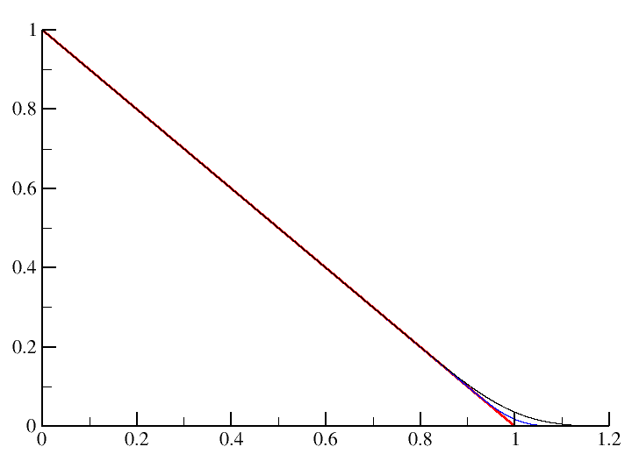
Floppy Modes
Examples
(total # of constraints placed)
(maximum # of independent constraints)
P =
F = <# of independent degrees of freedom>
uniform sampling
within A, B and C.
F
N₃
800 samples
C
B
A
N₂
Run body-bar pebble game for each sample, for nodes A, B and C.
P

Slide 17
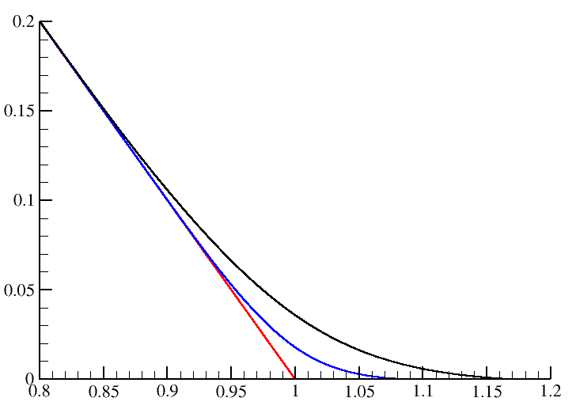
Floppy Modes
Examples
(total # of constraints placed)
(maximum # of independent constraints)
P =
F = <# of independent degrees of freedom>
uniform sampling
within A, B and C.
N₃
F
800 samples
C
B
A
Zoomed in
N₂
Run body-bar pebble game for each sample, for nodes A, B and C.
P

Slide 18
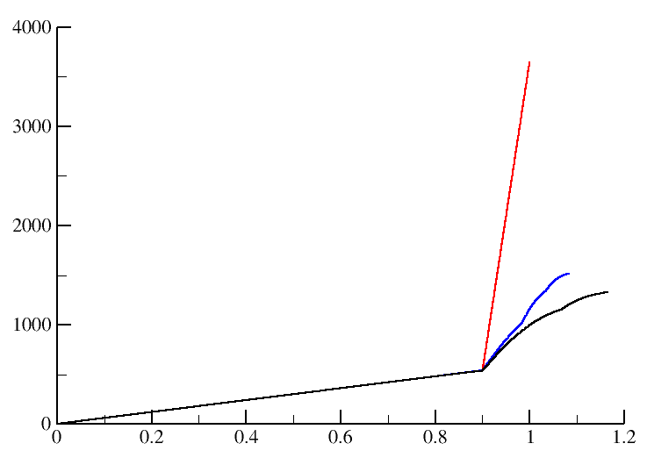
Pure Entropy
Examples
(total # of constraints placed)
(maximum # of independent constraints)
P =
Constraints with lowest entropy are placed in sorted order to obtain a lowest upper bound estimate for total entropy.
τ = <total pure entropy of the network>
sorted
uniform sampling
within A, B and C.
τ
N₃
800 samples
C
B
A
N₂
Run body-bar pebble game for each sample, for nodes A, B and C.
P

Slide 19
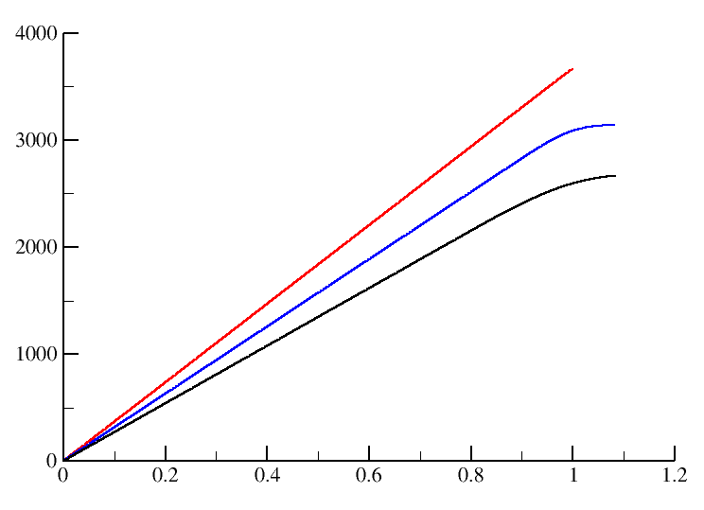
Pure Entropy
Examples
(total # of constraints placed)
(maximum # of independent constraints)
P =
Recall adding entropy components is over only independent constraints.
Therefore, the order that a constraint is tested for independence matters!
τ = <total pure entropy of the network>
random
no redundant constraints
uniform sampling
within A, B and C.
τ
N₃
800 samples
C
B
A
N₂
Lowest upper bound estimates
Run body-bar pebble game for each sample, for nodes A, B and C.
P

Slide 20
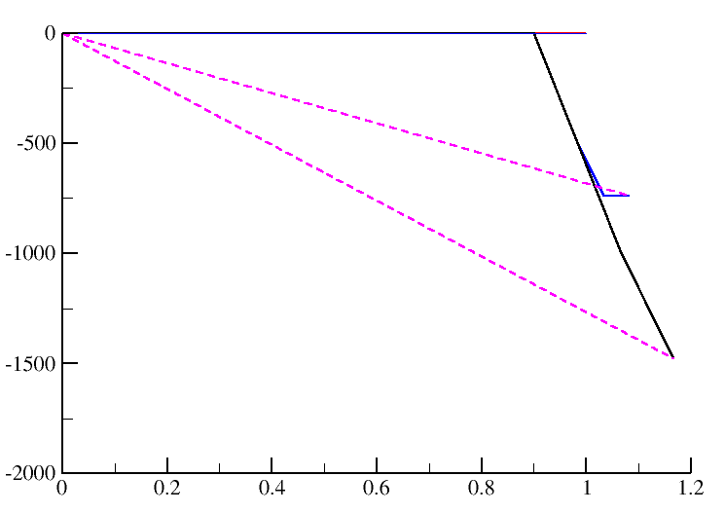
Enthalpy
Examples
(total # of constraints placed)
(maximum # of independent constraints)
P =
Recall adding energy components is over all constraints regardless if they are independent or redundant. Therefore, the sum is invariant to order.
H = <total enthalpy of the network>
any ordering
N₃
H
C
B
uniform sampling
within A, B and C.
A
N₂
800 samples
Run body-bar pebble game for each sample, for nodes A, B and C.
P

Slide 21
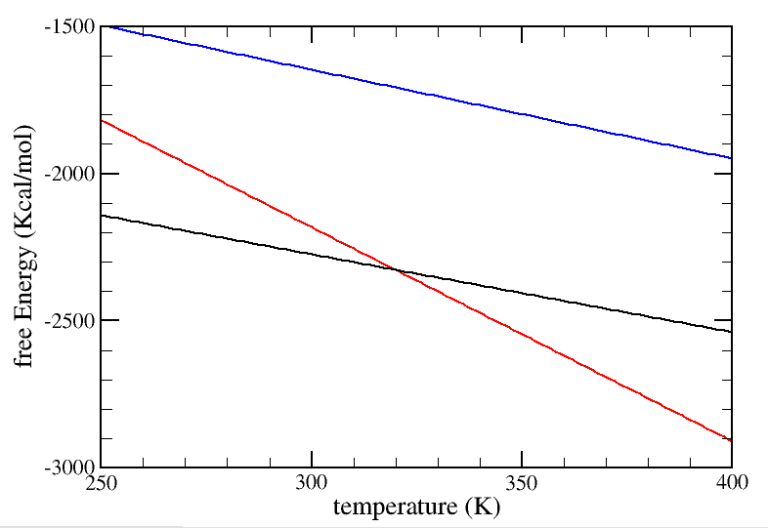
Thermodynamic and Mechanical Linkage
Free energy per node: G = H - TS
Remark: A free energy line is obtained for each macrostate represented as a node within the grid defined by order parameters.
The two state model of Schellmann is generalized.
A seemingly noncompetitive macrostate, but mixing entropy has not been included yet! B has more microstates than A and C.
N₃
C
B
uniform sampling
within A, B and C.
A
N₂
800 samples
Run body-bar pebble game for each sample, for nodes A, B and C.

Slide 22
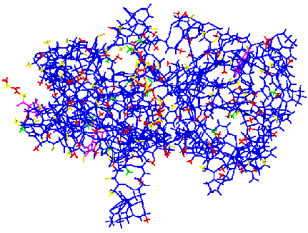
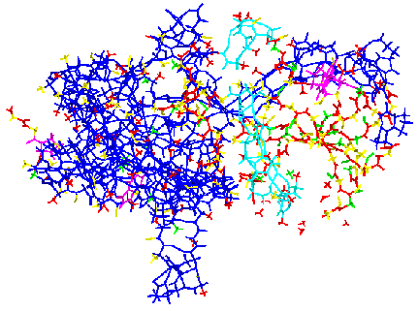
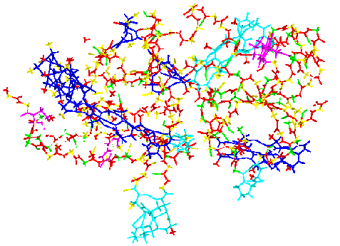
Partition Function
Ensemble of all accessible constraint topologies
-TS
H
H
-TS
H
-TS
Network of constraints defines microstate of the system
Let γ_{t} ≡ S_{t}/R Provides a dimensionless pure entropy
Suppose: γ₁ < γ₂ < γ₃ < … Ordering of entropies is important
E = N₁ε₁ + N₂ε₂ + N₃ε₃ + …. τ = I₁γ₁ + I₂γ₂ + I₃γ₃ + ….
H
Z
-βH(F)
Total enthalpy at fixed constraint topology
Total pure entropy. Conformational degeneracy = e^{τ}
Sum over all topologically distinct mechanical frameworks
Jacobs, et. al., Phys. Rev. E 68, 061109 (2003).

Slide 23
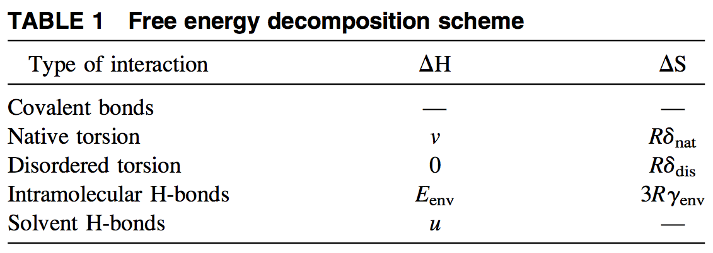
Free Energy Decomposition Scheme
Native interactions defined by protein structure at atomic resolution
env = environment that depends on local geometry and local chemistry.
(E_{h}, γ_{h})
Covalent bonds ➔Being quenched, no need to assign energy and entropy values.
Native torsions ➔Well-packed atoms resemble native representative structure.
Disordered torsions ➔Disrupts atomic packing in native representative structure.
Intramolecular H-bonds ➔Drives protein to the native representative structure.
Solvent H-bonds ➔H-bonds forming to mobile solvent do not restrict conformation.
Jacobs & Dallakyan (2005) Biophysical J. 88:903

Slide 24
Microenvironments Modify H-bond Characteristics
Modeling the strength of an intramolecular H-bond
H-bond strength is highly variable
H-bond energy function used is from:
B.I. Dahiyat, D.B. Gordon and S.L. Mayo. Protein Sci. 6:1333–1337 (1997).
Use the native protein structure (e.g. from x-ray crystal structure) to identify geometry, and apply the H-bond energy function that depends on both geometry and chemistry.
V
depends on
context
Energy of the h-th H-bond.
Pure entropy of the h-th H-bond.
Model entropy as a linear function of energy:
In units of kcal/mol:
Maximum gain in pure entropy that can be obtained by breaking the strongest possible H-bond.
Jacobs & Dallakyan (2005) Biophysical J. 88:903

Slide 25
Partition Function
Ensemble of all accessible constraint topologies
2^{Nt} number of terms
2^{Nh} number of terms
For N_{t}=1200 and N_{h}=400 there would be 2¹⁶⁰⁰ distinct constraint topologies.
Allowed Q-values: q_{nt} = {0, 1}, q_{dt} = {0, 1} and q_{h} = {0, 1, 2, 3}.
Use pebble game per constraint topology to calculate {q_{nt} , q_{dt} , q_{h}} that give the # of independent constraints when the interaction is present. Network rigidity couples all Boltzmann factors in a non-trivial way beyond Maxwell constraint counting.
Entire ensemble of constraint topologies = sum over all sub-ensembles.
Macrostate (N_{nt}, N_{hb}) defines (# of native torsions, # of H-bonds) in the protein.
Constraint topologies consistent with macrostate (N_{nt}, N_{hb}) define a sub-ensemble.
= the partition function for a protein within the macrostate (N_{nt}, N_{hb}).
Jacobs & Dallakyan (2005) Biophysical J. 88:903

Slide 26
Partition Function
Ensemble of all macrostates
0 ≤ N_{nt} ≤ N_{t}
0 ≤ N_{hb} ≤ N_{h}
Sum over macrostates
where
Free Energy Landscape (FEL) defined by two order parameters.
For N_{t}=1200 and N_{h}=400 there would be 2¹⁶⁰⁰ distinct constraint topologies.
and 480,000 distinct macrostates (grid nodes).
schematic
N_{nt}
Note: To calculate the partition function, Z, exactly is intractable. It is also generally intractable to exactly calculate the partition function for a macrostate. To solve for the free energy of a protein, Monte Carlo sampling is performed over millions of constraint topologies within a free energy functional approach.
N_{hb}
Jacobs & Dallakyan (2005) Biophysical J. 88:903

Slide 27
Calculating the Free Energy of a Protein
Transform problem of calculating Z to solving a free energy functional
--- by restricting to sub-ensembles
--- free energy functional
In principle
reflects local environments
The mDCM treats all torsions as equivalent
Based on native geometries
reflects local environments
Average total energy of all intramolecular H-bonds present
also see next page
Jacobs & Dallakyan (2005) Biophysical J. 88:903

Slide 28
Calculating the Free Energy of a Protein
Torsion and H-bond interactions define thermodynamic subsystems
Probability functions are to be determined
Remark: The random events of torsion interactions being native-like or disordered, or whether a native H-bond is maintained in the protein structure (present) or is broken, are all modeled as independent through a product probability distribution ansatz.
Monte Carlo Sampling: Drawing from the set of probabilities (yet to be determined), each H-bond is randomly selected to be present or not and each torsion is randomly selected to be native-like or disordered. This generates a random sampled constraint topology used to calculate conformational entropy for specified macrostate.
Jacobs & Dallakyan (2005) Biophysical J. 88:903

Slide 29
Calculating the Free Energy of a Protein
Monte Carlo Sampling Algorithm to obtain conformational entropy
Feeble H-bonds are always redundant.
stack of bars
sorted
Monte Carlo Sampling Algorithm
If( ranx < p^{(nt)} ) then make torsion native-like, otherwise disordered.
If( ranx < p^{(hb)} ) then h-th H-bond is present, otherwise it is broken.
Sort order constraints by entropy in a “first in, first out” stack: From stack, place covalent bonds, strong H-bonds from strongest to weakest until the next strongest constraint is a native torsion. Then, place all native torsions, and continue to place weak H-bonds from strongest to weakest until the disordered torsions are reached.
Play bar-body pebble game: Recursively place constraints in the network from strongest to weakest following the sorted stack.
Add pure entropy contributions from all independent constraints.
Return to step 1 until requested number of samples are generated. Then average the results to estimate total conformational entropy.
dis
h
Weak
nat
strong
Jacobs & Dallakyan (2005) Biophysical J. 88:903

Slide 30
Calculating the Free Energy of a Protein
Functional form of the probability distributions
Apply uniformly to all torsions
For N_{nt} = average number of native-torsions:
For N_{hb} = average number of native H-bonds:
A Lagrange multiplier, μ, is introduced to satisfy the average number of H-bonds.
Inhomogeneous mean field theory
When using Monte Carlo to calculate the average conformational entropy, it is best to also average intramolecular H-bond energy so that compensating fluctuations will cancel each other out.
Solving the free energy functional has been reduced to minimizing a function of two variables, which are ( μ, p^{(nt)} ).
schematic
Remaining Task: Numerically solve for for each node on the grid. This means, adjust, μ, to obtain the desired number of H-bonds, and adjust p^{(nt)} to obtain the desired number of native-torsions. Use adaptive grid method for this. When finished note that the Free Energy Landscape is calculated.
N_{nt}
N_{hb}
Jacobs & Dallakyan (2005) Biophysical J. 88:903

Slide 31
minimal Distance Constraint Model (mDCM)
Macrostates are defined within constraint space
Mean Field Theory:
Jacobs & Dallakyan (2005) Biophysical J. 88:903
Livesay et al. (2004) FEBS Letters 576:468
for given
template structure
Free energy function: G(N_{hb},N_{nt}) = U_{IHB} – u N_{hb} + v N_{nt} – T(S_{c}(δ_{nat}) + S_{mix})
apply this equation to all nodes
N_{nt}
F
more native torsion constraints
better atomic packing →
U
more H-bond crosslink constraints
N_{hb}
more stable secondary structure →

Slide 32
FEL and Ensembles of Constraint Topologies
Macrostates are defined within constraint space
Mean Field Theory:
Jacobs & Dallakyan (2005) Biophysical J. 88:903
Livesay et al. (2004) FEBS Letters 576:468
for given
template structure
Free energy function: G(N_{hb},N_{nt}) = U_{IHB} – u N_{hb} + v N_{nt} – T(S_{c}(δ_{nat}) + S_{mix})
apply this equation to all nodes
N_{nt}
+ . . .
F
more native torsion constraints
+ . . .
better atomic packing →
sub-ensembles
of constraint
topologies
U
+ . . .
more H-bond crosslink constraints
N_{hb}
more stable secondary structure →
hb

Slide 33
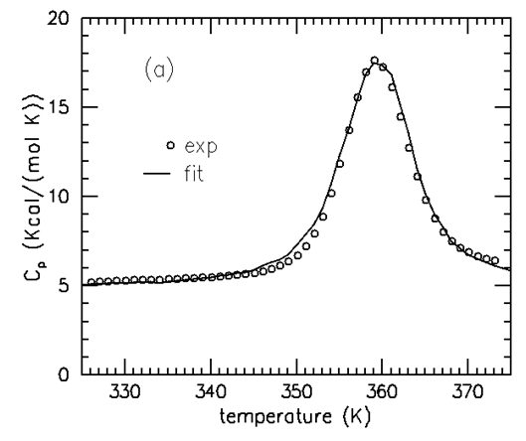
Protein Thermodynamics
Empirical model with 3 fitting parameters: mDCM
Mean Field Theory:
Jacobs & Dallakyan (2005) Biophysical J. 88:903
Livesay et al. (2004) FEBS Letters 576:468
Free energy function: G(N_{hb},N_{nt}) = U_{IHB} – u N_{hb} + v N_{nt} – T(S_{c}(δ_{nat}) + S_{mix})
Experimental input data
NATIVE STRUCTURE + HEAT CAPACITY
Simulated annealing over u, v, δ_{nat}
DCM
OUTPUT
includes
FREE ENERGY
LANDSCAPES

Slide 34
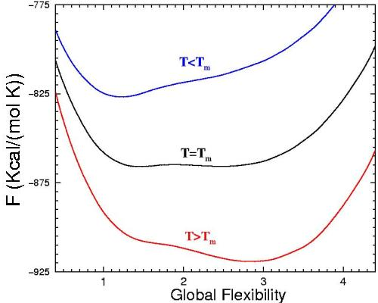
1D Free Energy Landscape
Free energy is directly related to the global flexibility of a protein
number of independent degrees of freedom
Global Flexibility
θ = flexibility order parameter =
number of residues

Slide 35
Reproducing Essential Features in Protein Heat Capacity
Over 25 diverse protein folds fit well to a 3 free parameter model
D. Livesay, et. al., FEBS Letters, 576, 468-476 (2004).
protein G
BPTI
CSP (pH4)
GDH n-term domain
CSP (pH8)
UBQ (pH2)
HIV protease
halo-HBP
Fibronectin
Lysozyme
RNase H
apo-HBP

Slide 36
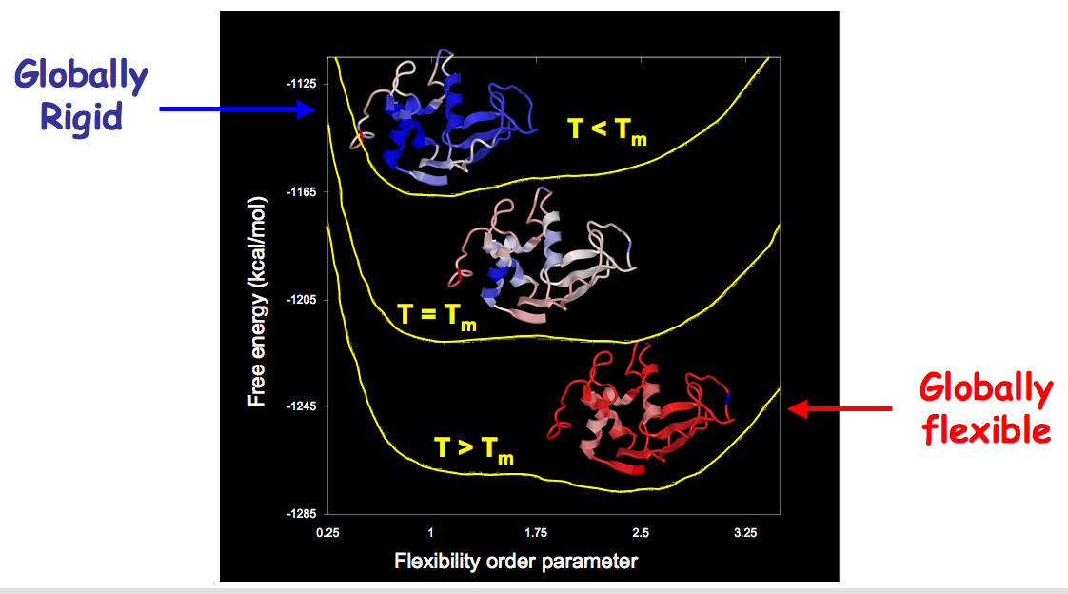
Quantified Stability/Flexibility Relationships (QSFR)
One dimensional free energy landscape

Slide 37
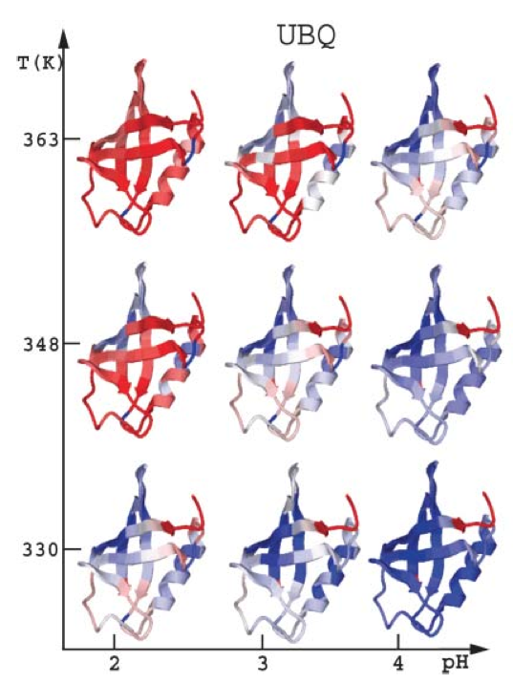
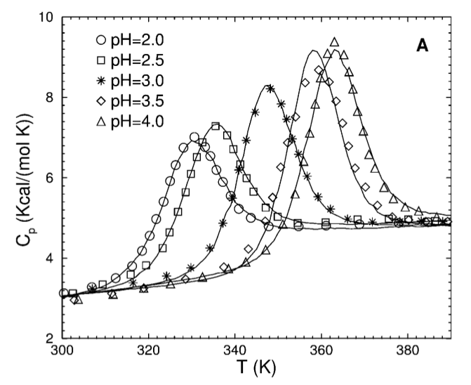
minimal Distance Constraint Model (mDCM)
pH dependence on stability and backbone flexibility in ubiquitin
Jacobs and Dallakyan (2005). Biophys J, 88:903-915

Slide 38
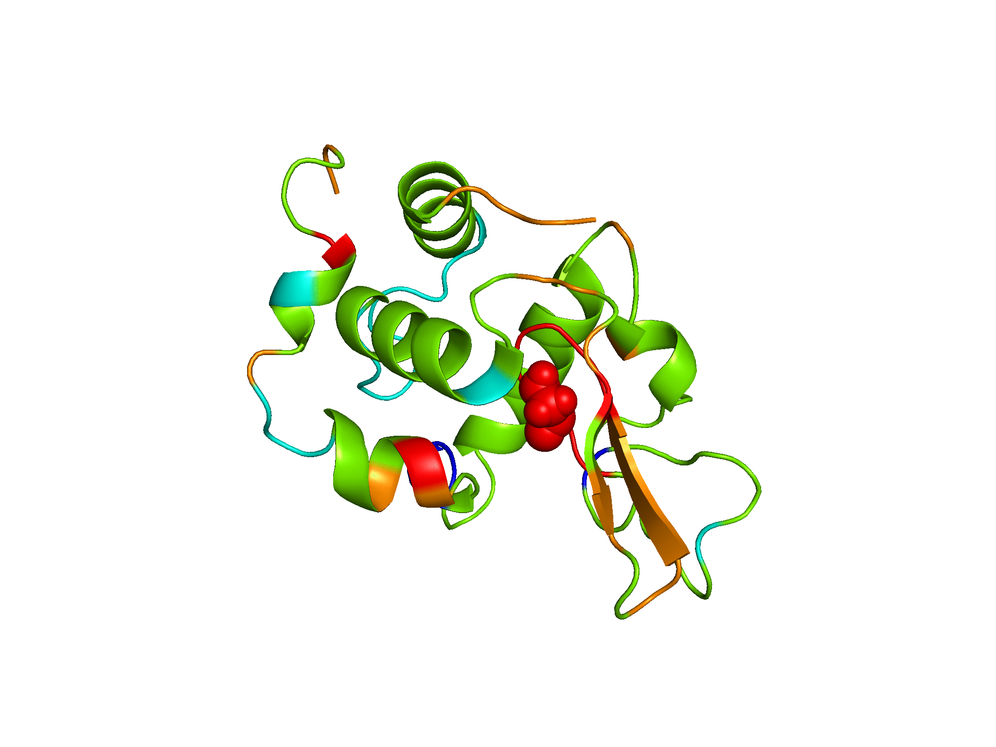
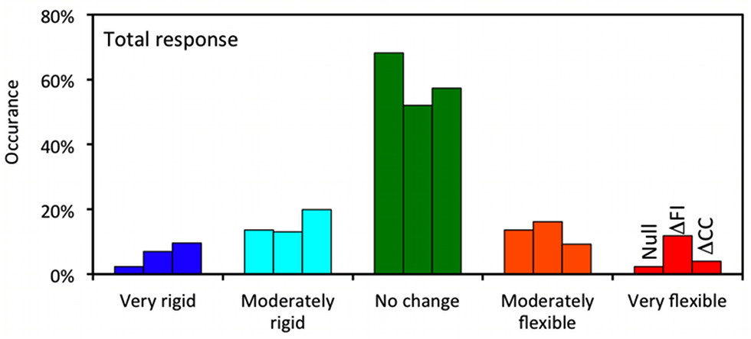
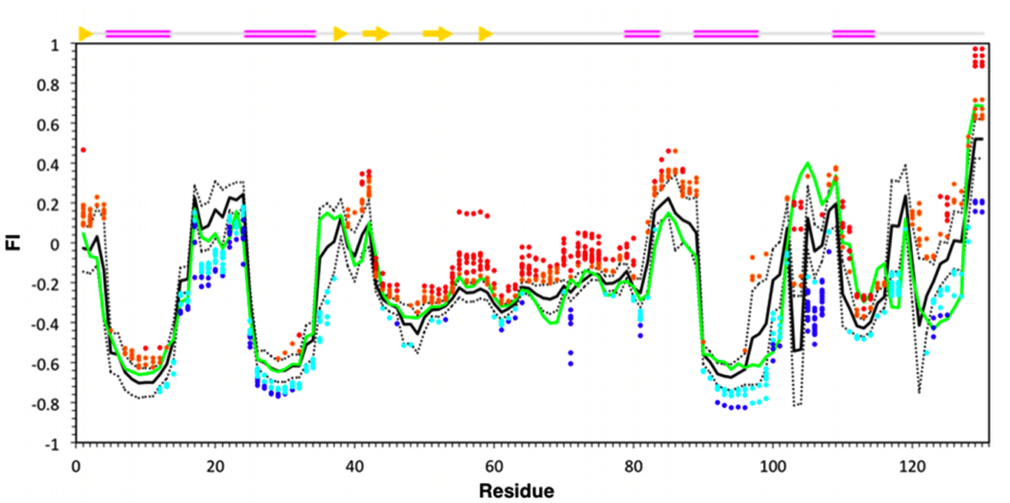
Changes in lysozyme flexibility upon mutation
are frequent, large and long-ranged
Verma et al (2012)
PLoS Comp Biol, 8:1002409.

Slide 39
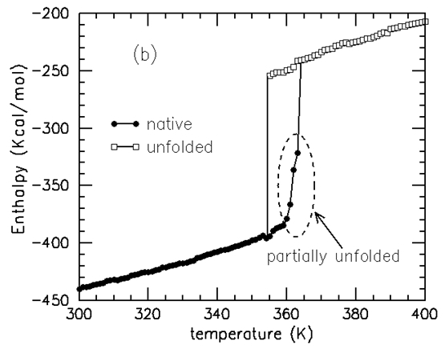
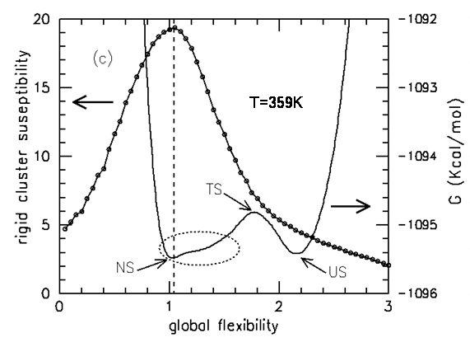
Protein stability is directly related to global flexibility
Mechanical and thermodynamic transitions are distinct
Global flexibility = average number of independent degrees of freedom
number of residues
Native basin of thioredoxin (TRX) has greatest rigid ⇔ flexible fluctuations
mDCM does not assume two-state behavior
D.J. Jacobs, et. al., Journal of Molecular Biology. 358, 882-904 (2006)

Slide 40
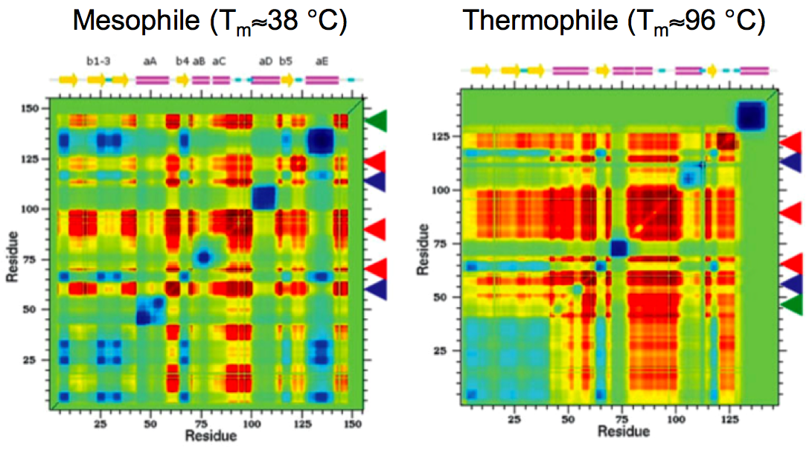
Molecular Cooperativity Correlation Plots
Comparison of mesophilic and thermophilic RNase H orthologs
Mesophile (T_{m}≈38 °C)
Thermophile (T_{m}≈96 °C)
D.R. Livesay and D.J. Jacobs, Proteins, 62, 130-43 (2006)

Slide 41
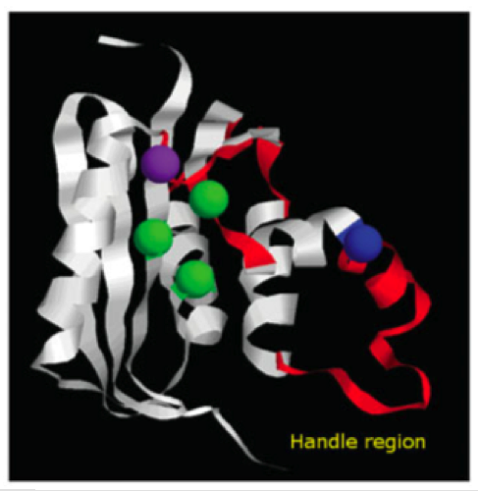
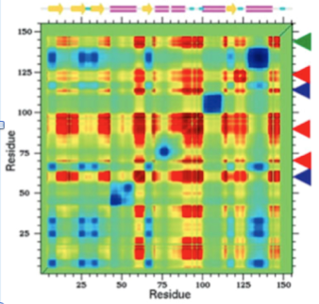
Molecular Cooperativity Correlation Plots
Example of biochemical allostery
Cooperativity highlighted in red
D.R. Livesay and D.J. Jacobs, Proteins, 62, 130-43 (2006)

Slide 42
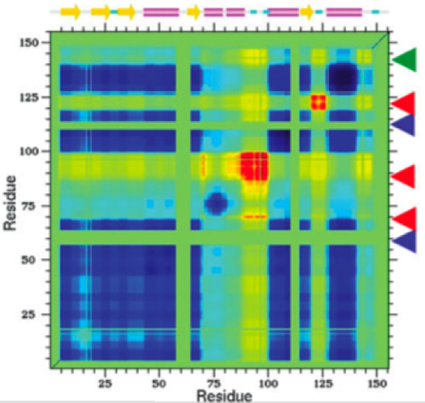
Molecular Cooperativity Correlation Plots
Example of biochemical allostery
Add constraints in flexibly correlated region far from active site
Cooperativity highlighted in red
Dramatic increase in co-rigidity
D.R. Livesay and D.J. Jacobs, Proteins, 62, 130-43 (2006)

Slide 43
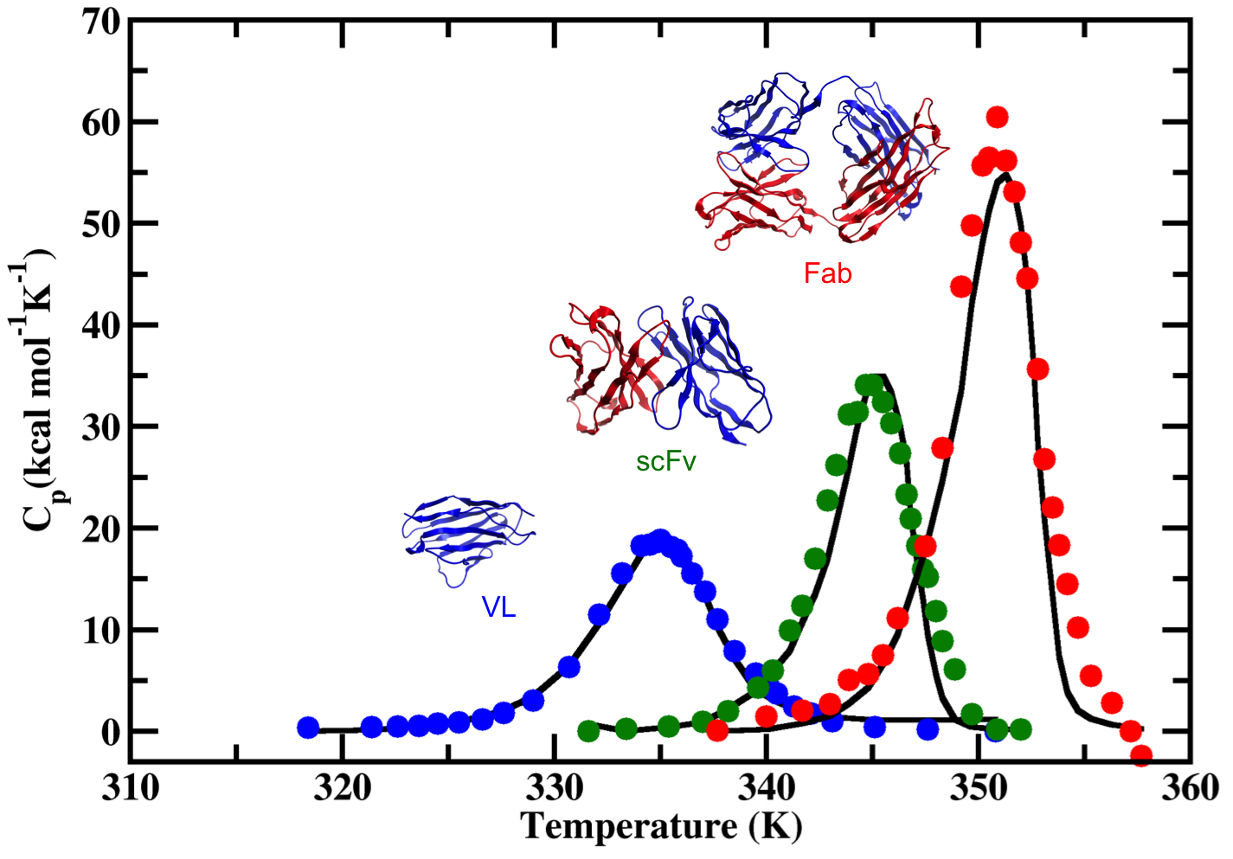
Application to Antibody fragments
Model parameterization works across diverse length scales
Tong Li, Deeptak Verma, Malgorzata B. Tracka, Jose Casas-Finet, Dennis R. Livesay and Donald J. Jacobs, Thermodynamic stability and flexibility characteristics of antibody fragment complexes, Protein and Peptide Letters (2014).

Slide 44
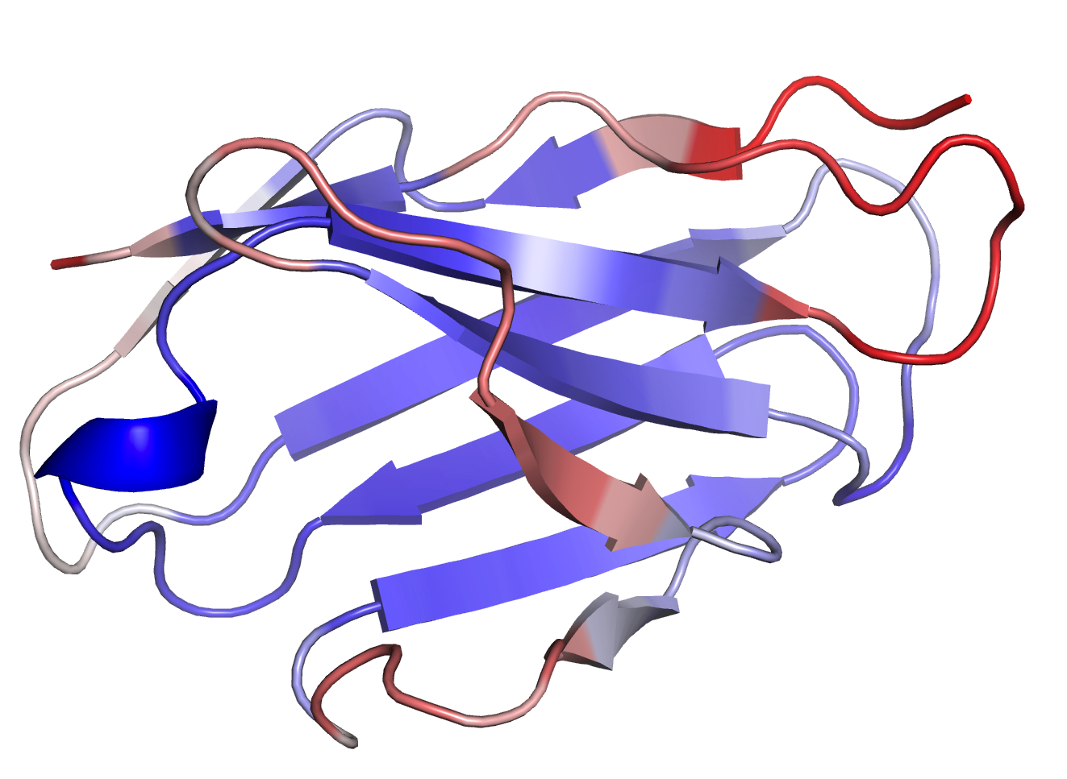
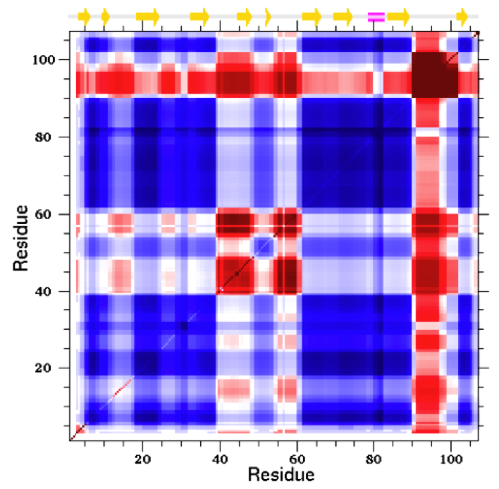
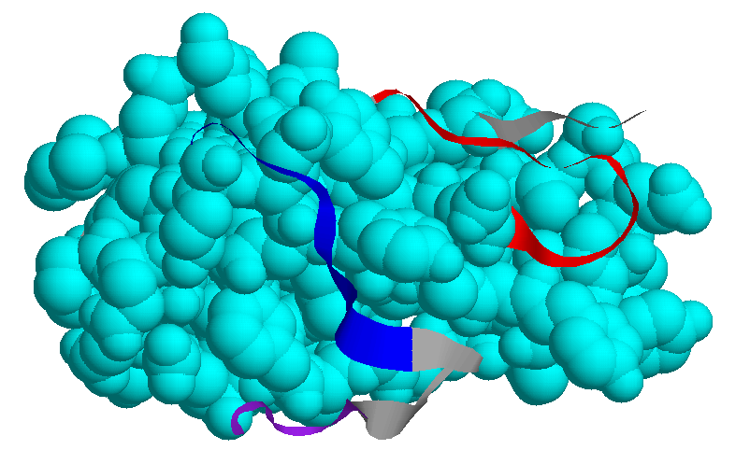
QSFR for an Isolated Antiferritin VL Domain
Long-range couplings suggest interesting functional mechanism
Long-range couplings: The two poles of the VL domain are mechanistically coupled through correlated dynamics.

Slide 45
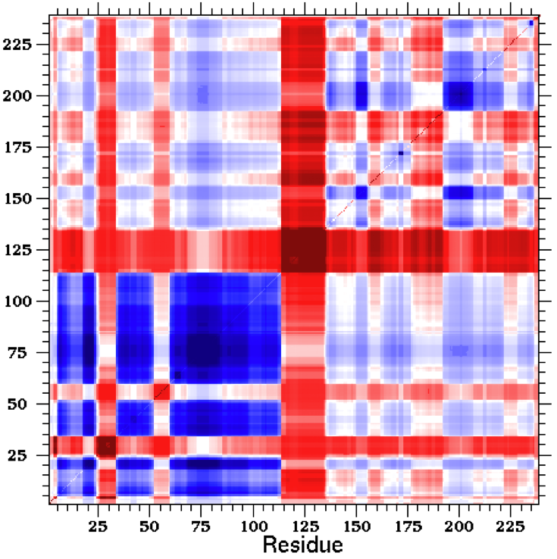
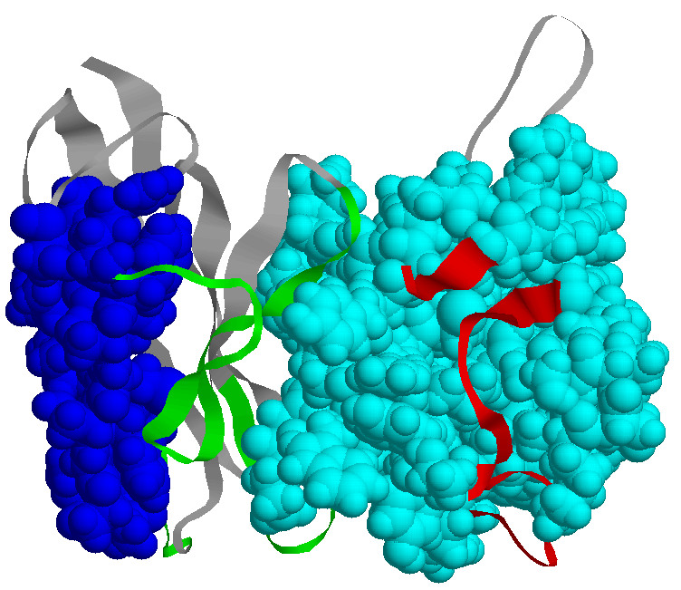
A P104D mutant scFv fragment
The (VH, VL) domains are primarily (co-rigid, co-flexible)
Linker
L3
L2
L1
scFv Linker
H1
H2
Tong Li, Malgorzata B. Tracka, Jose Casas-Finet, Donald J. Jacobs and Dennis R. Livesay, Redistribution of Flexibility in Stabilizing Antibody Mutants Follows Le Châtelier’s Principle, PLoS ONE 9(3):p. e92870 (2014).

Slide 46
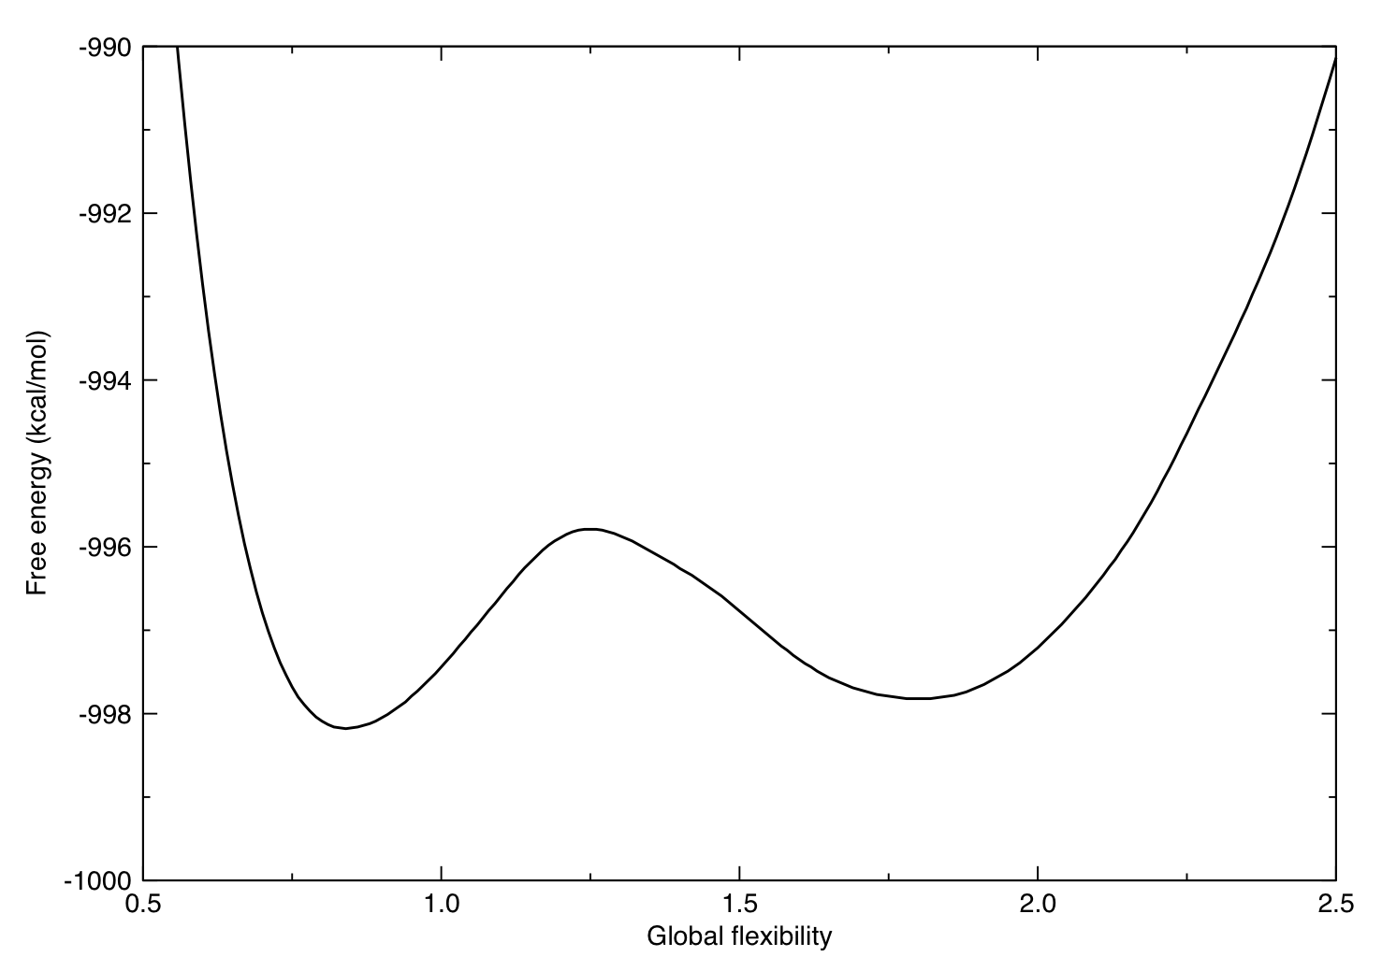
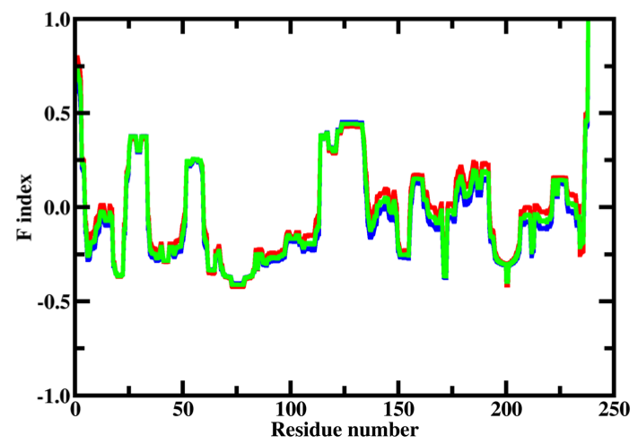
Workflow for Applications
Analysis on one or more X-ray crystal structures
X-ray structure
static conformation
output & results →
QSFR
A set of metrics

Slide 47
Mitigating Sensitivity on Input Structure
Molecular dynamics simulation is used to boost statistics
X-ray structure
sampling by
molecular dynamics
multiple conformations
output & results →
{QSFR}
Many sets of metrics

Slide 48
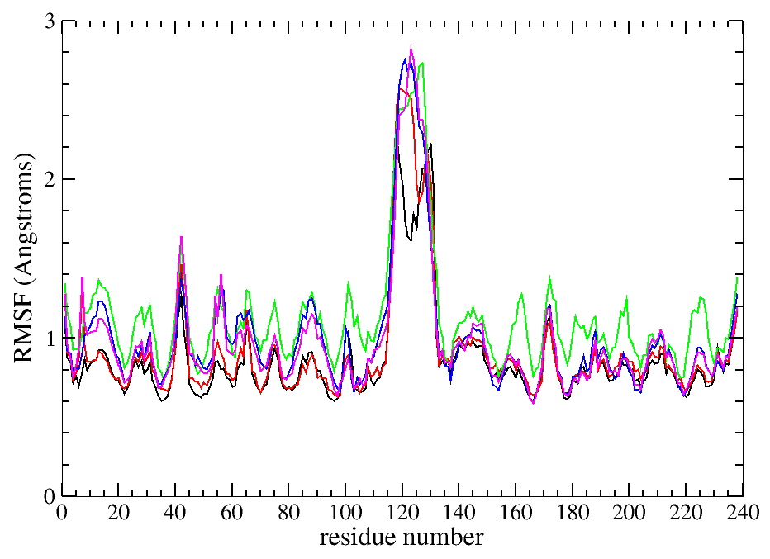
Mitigating Sensitivity on Input Structure
Molecular dynamics simulation is used to boost statistics
covariance matrix
DYNAMICS
X-ray structure
Sampling
rmsf
bonus
molecular dynamics
multiple conformations
output & results →
{QSFR}
Many sets of metrics

Slide 49
Summary of the mDCM
Strengths:
The mDCM is based upon a simple free energy decomposition scheme applicable to proteins that only heat denature. The FED retains three phenomenological parameters that are adjusted to fit heat capacity data.
mDCM (or other DCM variants) is the only all-atom statistical mechanics model that has successfully reproduced experimental heat capacity data.
The method used to create an inhomogeneous mean field theory can be used quite generally for many different statistical physics problems.
“Everything should be made as simple as possible, but not simpler”
--- Albert Einstein
Weaknesses:
Residues are not modeled with local environment context dependence, and without their own distinct characteristics.
The employed trial probability functions for the inhomogeneous mean field theory are not self-consistent with the free energy reconstitution.
Only one protein structure can be used to define a native template.

